Slide 1
Topic 8 Energetics & Thermochemistry
Wilt Gu

Slide 2
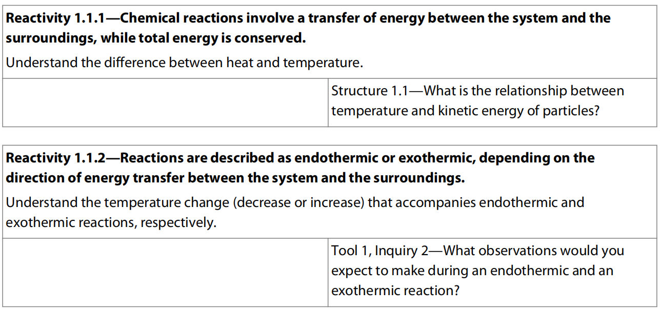
8.1 Measuring Energy Changes

Slide 3
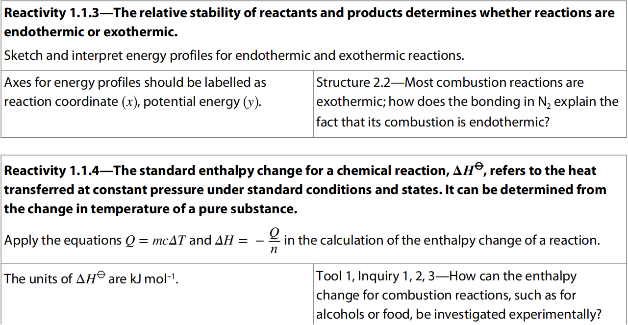
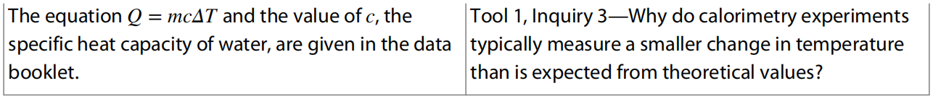

Slide 4
Energy and heat transfer energy
Energy is a measure of the ability to do work, that is to move an object against an opposing force.
It comes in many forms and includes heat, light, sound, electricity, and chemical energy – the energy released or absorbed during chemical reactions

Slide 5
Thermochemistry
Thermochemistry is the study of the energy (unit: joules, J, or kilojoules, kJ) and heat associated with chemical reactions and/or physical transformations. A reaction may release or absorb energy, and a phase change may do the same, such as in melting and boiling.

Slide 6
System and surroundings
Chemical and physical changes take place in many different environments such as test tubes, polystyrene cups, industrial plants and living cells.
System – the area of interest
Surroundings – in theory everything else in the universe
Most chemical reactions take place in an open system which can exchange both energy and matter with the surroundings.
A closed system can exchange energy but not matter with the surroundings.
An isolated system can exchange neither energy nor matter with the surroundings.

Slide 7
The 1st Law of Thermodynamics
The law of Conservation of Energy: the total energy of an isolated system is constant; energy can be transformed from one form to another, but cannot be created or destroyed.
Energy can only be exchanged between a system and the surroundings, but the total energy cannot change during the process
Therefore, any energy lost by the system is gained by the surroundings and vice versa.

Slide 8
Enthalpy, H
Enthalpy, H (unit joules: J or kJ) is the total heat content of a system, some of which is stored as chemical potential energy in the chemical bonds.
Absolute H can not be measured, but the change ΔH can.
In chemical reaction, bonds are broken and made, energy absorbed and released.
Enthalpy change of reaction ΔH (unit: kilojoules per mole, kJ/mol) equal to the difference in enthalpy between the reactants and the products.

Slide 9
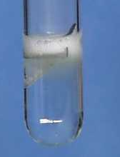
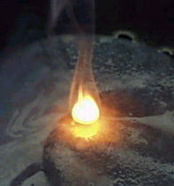
Exothermic Reactions
Exothermic reactions releases energy from the system to the surrounding, and increases in temperature.
Examples include:
Combustion reactions including the combustion of fuels.
Detonation of explosives.
Reaction of acids with metals.
Neutralization
Magnesium reacting with acid
Combustion reaction

Slide 10
Exothermic Reactions
Magnesium + Hydrochloric acid
25º C
45º C
magnesium
Heat
energy
given
out
Gets hot
Hydrochloric
acid

Slide 11
Exothermic Reactions
If heat is given out from the system to the surrounding, this energy must have come from chemical energy in the starting materials (reactants).
45º C
25º C
Reactants convert chemical energy to heat energy.
The temperature rises.

Slide 12
Energy Level Diagram for an
Exothermic Reaction
Reactants have more chemical energy.
reactants
Some of this is lost as heat which spreads out into the room.
Energy / kJ)
Products now have less chemical energy than reactants.
products
Progress of reaction (time)

Slide 13
Energy Level Diagram for an
Exothermic Reaction
Energy Level Diagram for an
Exothermic Reaction 2.
ΔH is how
much energy
is given out
reactants
ΔH is negative
because the products have less energy than the reactants.
ΔH=negative
Energy / kJ
products
Progress of reaction

Slide 14
Exothermic Reaction - Definition
Exothermic reactions give out energy. There is a temperature rise and ΔH is negative.
reactants
Energy / kJ)
ΔH is negative
products
Progress of reaction

Slide 15
Activity
Say whether these processes are exothermic.
Charcoal burning
A candle burning.
A kettle boiling
Ice melting
A firework exploding
yes
yes
no
no
yes
You have to put heat in for boiling and melting.
You get heat out from all the other processes

Slide 16
Endothermic Reactions
Endothermic reactions absorbs energy from the surrouding to the system, and decreases in temperature.
25º C
5º C
Ammonium
nitrate
Cools
Water
Starts 25°C
Cools to 5°C

Slide 17
Endothermic Reactions
Extra energy is needed in order for endothermic reactions to occur.
This comes from the thermal energy of the reaction mixture which consequently gets colder.
5º C
25º C
Reactants convert heat energy into chemical energy as they change into products. The temperature drops.

Slide 18
Energy Level Diagram for an
Endothermic Process
This is how
much energy
is taken in
products
This is positive
because the products have more energy than the reactants.
Energy / kJ)
ΔH=+
reactants
Progress of reaction

Slide 19
Endothermic Reaction Definition
Endothermic reactions take in energy. There is a temperature drop and ΔH is positive.
products
ΔH=+
Energy / kJ
reactants
Progress of reaction

Slide 20


Slide 21
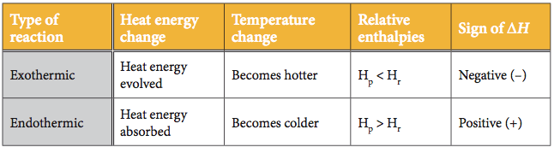
Exo V.S. Endo

Slide 22
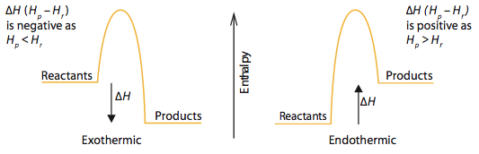
Exothermic V.S. Endothermic

Slide 23
Activity
Are these endothermic or exothermic?
A red glow spread throughout the mixture and the temperature rose.
The mixture bubbled vigorously but the temperature dropped 15⁰C.
Hydrazine and hydrogen peroxide react so explosively and powerfully that they are used to power rockets into space.
The decaying grass in the compost maker was considerably above the outside temperature.
exo
endo
exo
exo

Slide 24
Thermochemical standard conditions
It is defined as a temperature of 25 °C (298K),
a pressure of 100 kPa with all solutions having a concentration of 1 mol/L.
Different from standard temperature and pressure (S.T.P.) for gases
Use “o”, a ‘standard’ sign as superscript to indicate: ΔHº

Slide 25
Thermochemical Equations
The combustion of methane can be described by the thermochemical equation:
CH₄(g) + 2 O₂(g) → CO₂(g) + 2 H₂O(l) ΔHº = -890kJ mol⁻¹
This is a shorthand way of expressing information that one mole of methane gas reacts with two moles of oxygen gas to give one mole of gaseous carbon dioxide and two moles of liquid water and releases 890 kJ of heat energy.
For exothermic reaction the enthalpy change should be always negative since the system loses some energy.

Slide 26
The thermochemical equation for photosynthesis can be represented as:
6 CO₂ (g) + 6 H₂O (l) → C₆H₁₂O₆ (aq) + 6 O₂ (g)
ΔHº = +2802.5 kJ mol^{–1}
which means that 2802.5 kJ of energy is absorbed when one mole of aqueous glucose is formed under standard conditions from gaseous carbon dioxide and liquid water.
The enthalpy change of an endothermic reaction should always be positive since the system gains some energy.

Slide 27
Temperature is a measure of average kinetic energy
The movement or kinetic energy of the particles of a substance depends on the temperature.
If the temperature of a substance is decreased, the average kinetic energy of the particles also decreases.
Absolute zero (–273°C) is the lowest possible temperature attainable as this is the temperature at which all movement has stopped.
The absolute temperature, measured in Kelvin, is directly proportional to the average kinetic energy of its particles.

Slide 28
Heat changes can be calculated from temperature changes
In general, the increase in temperature when an object is heated depends on:
The mass of the object
The heat added
The nature of the substance (specific heat capacity)
The specific heat capacity is the property of a substance which gives the heat needed to increase the temperature of unit mass by 1 K.
heat change (q) = mass (m) × specific heat capacity (c) × temperature change (ΔT)

Slide 29
Energy required (Q) =
mass heated (m)
x
energy needed to make 1 g of substance 1ºC hotter
x
temperature rise (∆T)

Slide 30
Energy required (Q) =
mass heated (m)
x
x
temperature rise (∆T)
specifc heat capacity (c)

Slide 31
Heat energy: Q = m c ∆T
J g (J K⁻¹ g⁻¹) K

Slide 33
Calorimetry
Is the technique used to measure the change of enthalpy associated with a particular reaction/process.
The temperature change of a liquid inside a well insulated container, known as a calorimeter, is measured before and after the change.

Slide 34
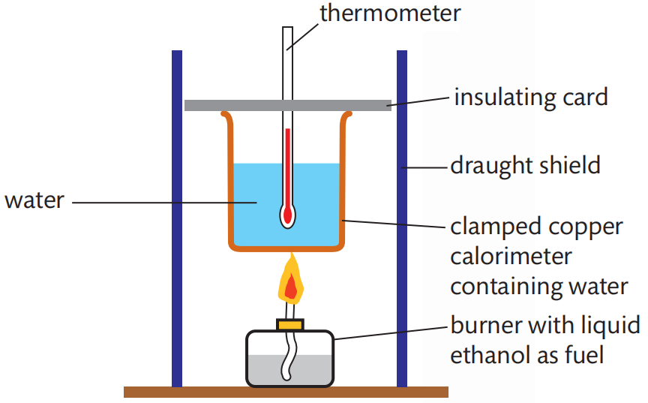
Measuring enthalpy changes of combustion

Slide 35
Calculating enthalpy changes of reaction from temperature changes
When the heat released by an exothermic reaction is absorbed by water, the temperature of the water increases. The heat produced by the reaction can be calculated if it is assumed that all the heat is absorbed by the water.
q_{reaction} = - q_{water} = - m_{(H2O)} × c_{(H2O)} × ΔT_{(H2O)}

Slide 36
Practice
Calculate the enthalpy of combustion of ethanol from the following data. Assume all the heat from the reaction is absorbed by the water. Compare your value with the IB data booklet value and suggest reasons for any differences.

Slide 37
q_{reaction}

Slide 38
The IB data booklet value is –1367 kJ mol^{–1}. The difference between the values can be accounted for by any of the following factors:
Not all the heat produced by the combustion reaction is transferred to the water. Some is needed to heat the copper calorimeter and some has passed to the surroundings.
The combustion of the ethanol is unlikely to be complete owing to the limited oxygen available, as assumed by the literature value.
The experiment was not performed under standard conditions.

Slide 39
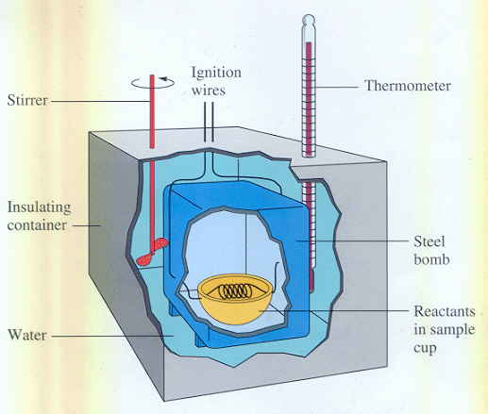
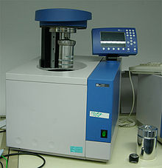
Bomb calorimeter --- to minimize the heat lost

Slide 40
Enthalpy changes of reaction in solution
The enthalpy changes of reaction in solution can be calculated by carrying out the reaction in an insulated system, for example, a polystyrene cup.
The heat released or absorbed by the reaction can be measured from the temperature change of the water.

Slide 41
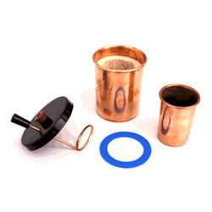
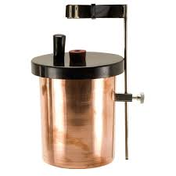
Copper calorimeter
Q= (m c ∆T) _{liquid} + (C ∆T) _{calorimeter}

Slide 42
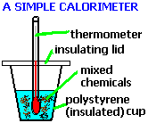
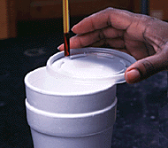
A convenient calorimeter---Styrofoam cup
Reason: it has low heat capacity (negligible)
And is a good insulator.
Heat absorbed Q= (m c ∆T) _{liquid}

Slide 43
Calorimetry depends on the assumption that all the heat absorbed or evolved only changes the temperature of the calorimeter and its contents, no heat is gained from or lost to the surroundings.
Insulation is important~!!
Major source of error of calorimetry in school labs is heat exchange with the surroundings

Slide 44
Assumptions to be made
No heat loss from the system
All the heat goes between the reaction and the water [The heat energy required to change the temperature of the other substances present may be ignored, in comparison to that needed to heat the water (usually in excess and has a very high specific heat capacity)]
The solution is dilute: V(solution) = V(H₂O)
Solution has the same density as water: 1.00 g cm^{–3}.
Solution has the same specific heat capacity as water: 4.18 J g⁻¹ K⁻¹
So: ΔH_{system} = 0 (assumption 1)
ΔH_{system} = q_{water} + q_{reaction} (assumption 2)
q_{reaction} = – q_{water}

Slide 45
For an exothermic reaction, q_{reaction} is negative as heat has passed from the reaction into the water.
q_{water} = m(H₂O) × c(H₂O) × ΔT(H₂O)
The limiting reactant must be identified in order to determine the molar enthalpy change of reaction.
×coefficient of limiting reactant in the equation

Slide 46
Getting the maximum temperature from experiment considering the heat loss to surrounding
A known volume of copper sulfate solution is added to the calorimeter and its temperature measured every 25 s.
Excess zinc powder is added after 100 s and the temperature starts to rise until a maximum after which it falls in an approximately linear fashion.
Heat is lost from the system as soon as the temperature rises above the temperature of the surroundings, in this case 20 °C.
We can make some allowance for heat loss by extrapolating the cooling section of the graph to the time when the reaction started (100 s).

Slide 49
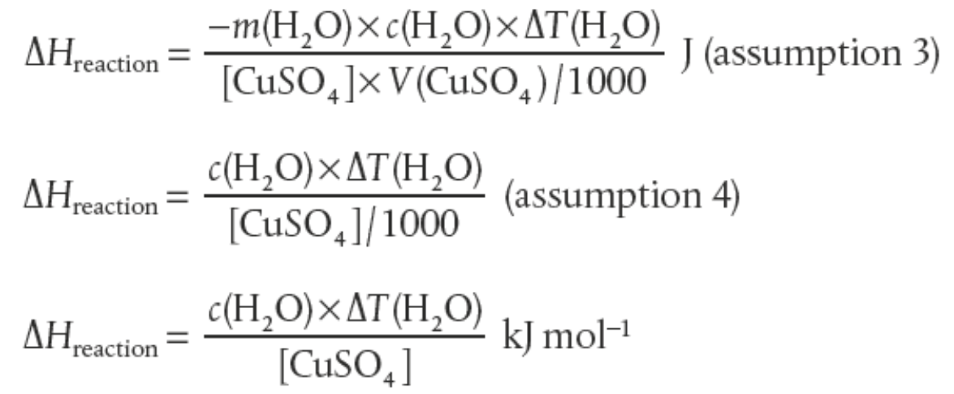
-
-

Slide 50
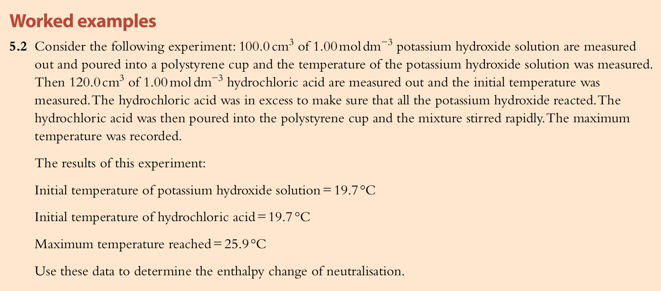
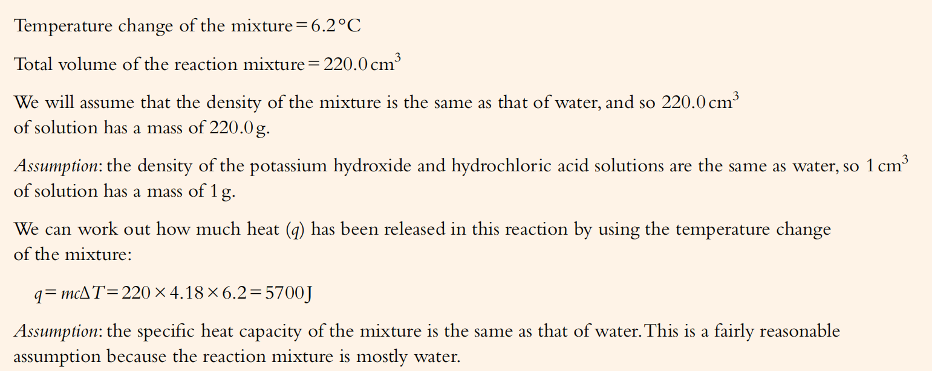

Slide 51
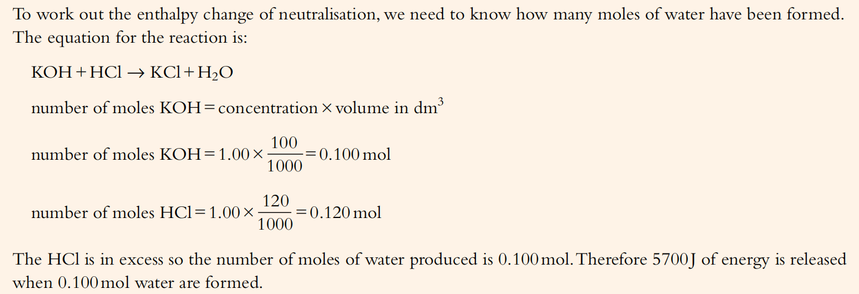
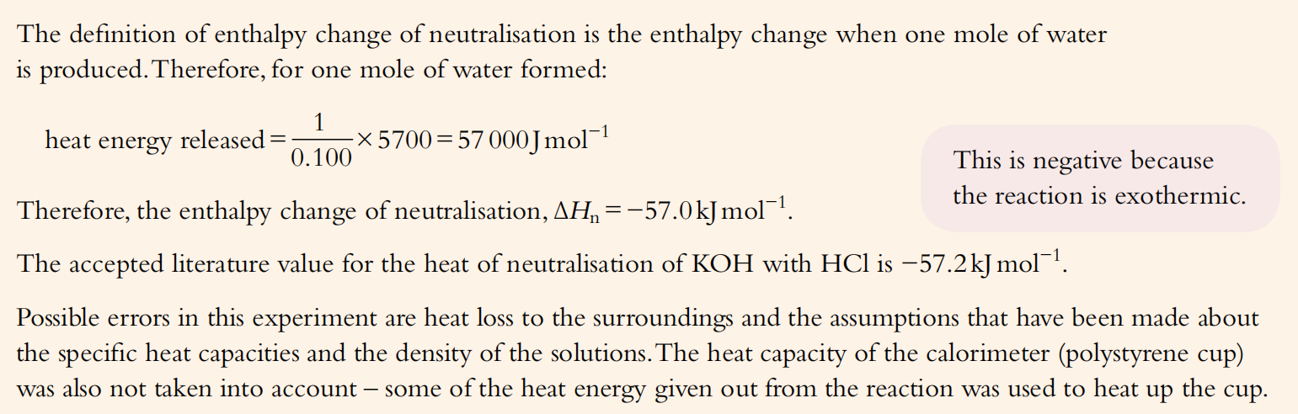

Slide 52
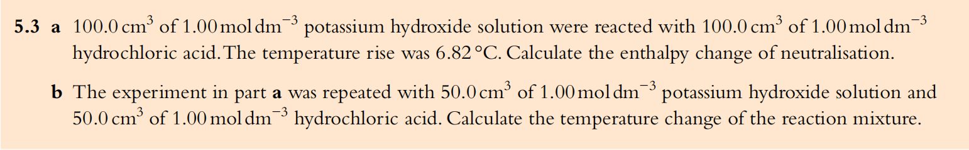
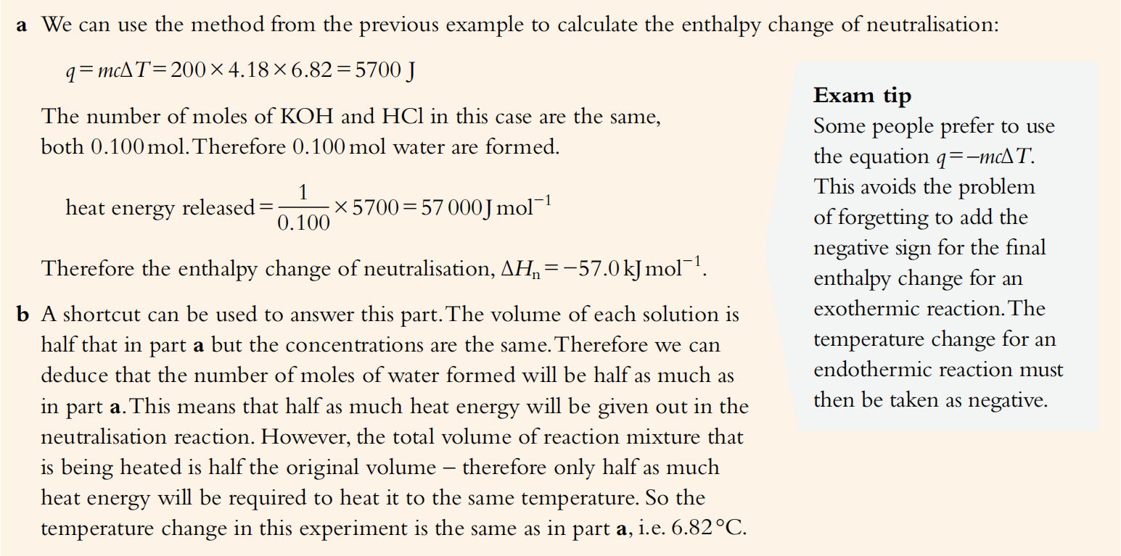

Slide 53
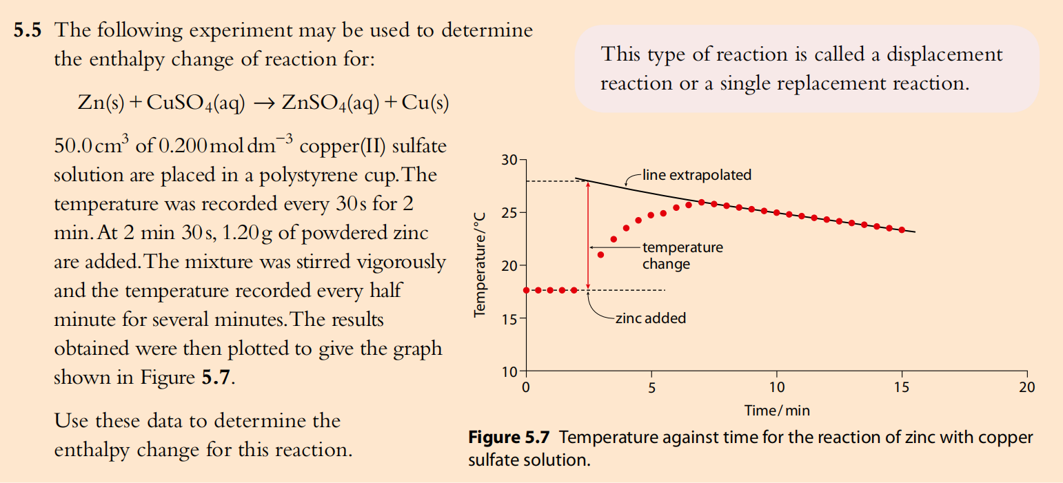

Slide 54
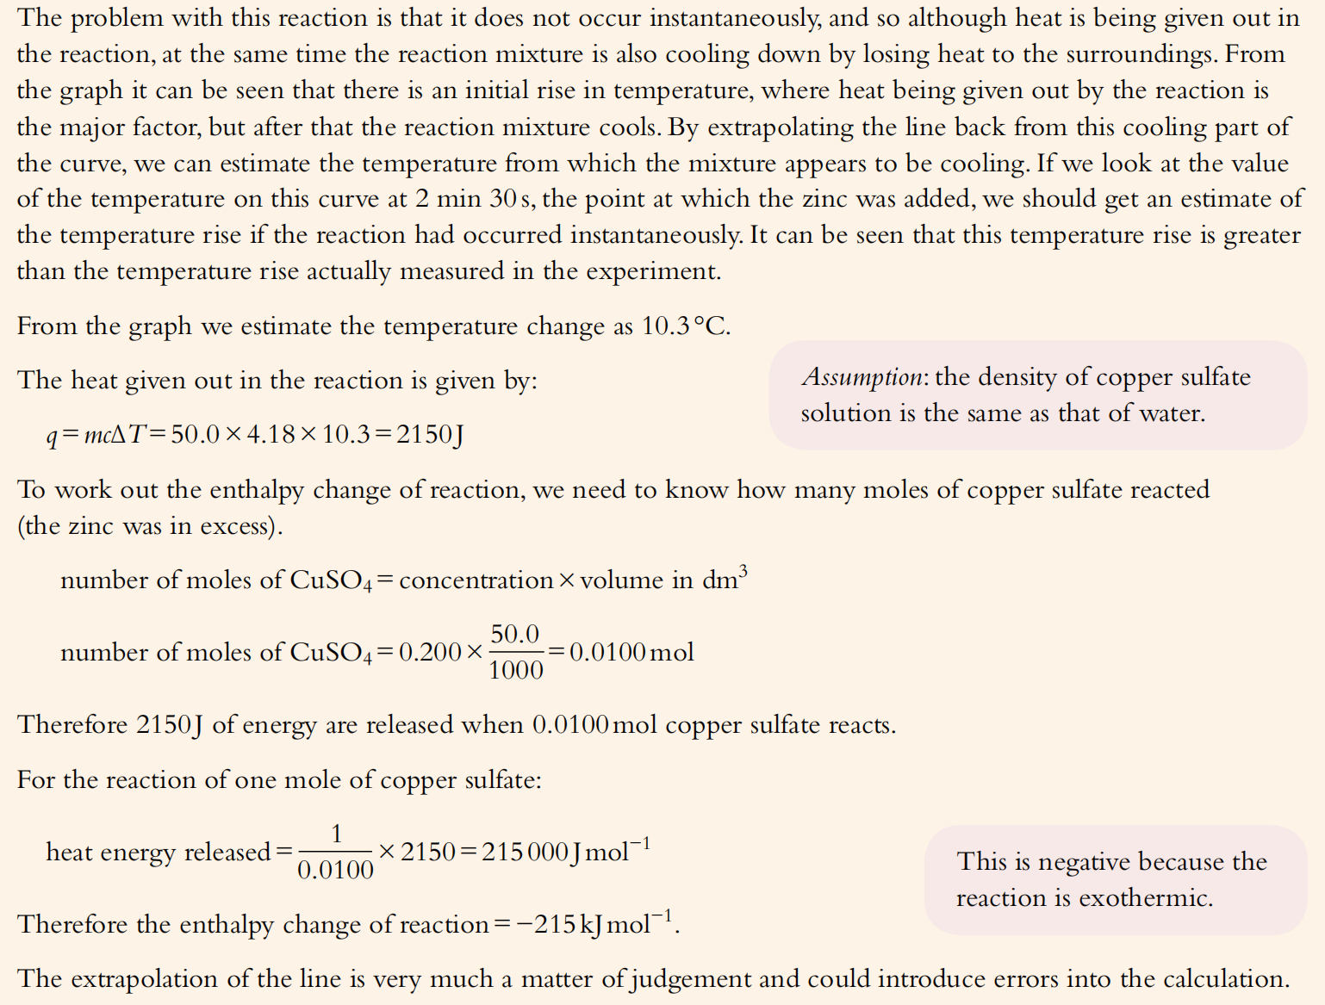

Slide 55
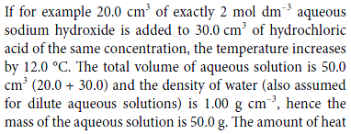
Practice:
Q= ?
∆H=?

Slide 56
Practice:
3.53 g of sodium hydrogen carbonate was added to 30.0 cm³ of 2.0 mol dm⁻³ hydrochloric acid. The temperature fell by 10.3 K. (Assume that the density of the solution is 1.00 g cm⁻³, the specific heat capacity of the solution is 4.18 J g⁻¹ K⁻¹.)
Q= ?
∆H=?

Slide 57
3.53 g of sodium hydrogen carbonate was added to 30.0 cm³ of 2.0 mol dm⁻³ hydrochloric acid. The temperature fell by 10.3 K. Work out which reagent was in excess and then calculate the enthalpy change for the reaction. Assume that the density of the solution is 1.00 g cm⁻³, the specific heat capacity of the solution is 4.18 J g⁻¹ K⁻¹.
Q = mc∆T
m = 30
c = 4.18
∆T = 10.3
Q = 30 x 4.18 x 10.3 = 1292 J
∆H = Q / n
n_{HCl} = c V
= 2.0 x ³⁰/₁₀₀₀ = 0.060 mol
n_{NaHCO3} = m / M_{r}
= 3.53 / 84.0 = 0.0420 mol
HCl + NaHCO₃ → NaCl + H₂O + CO₂
∆H = Q/n = 1.292 / 0.0420
= +30.8 kJ mol⁻¹

Slide 58
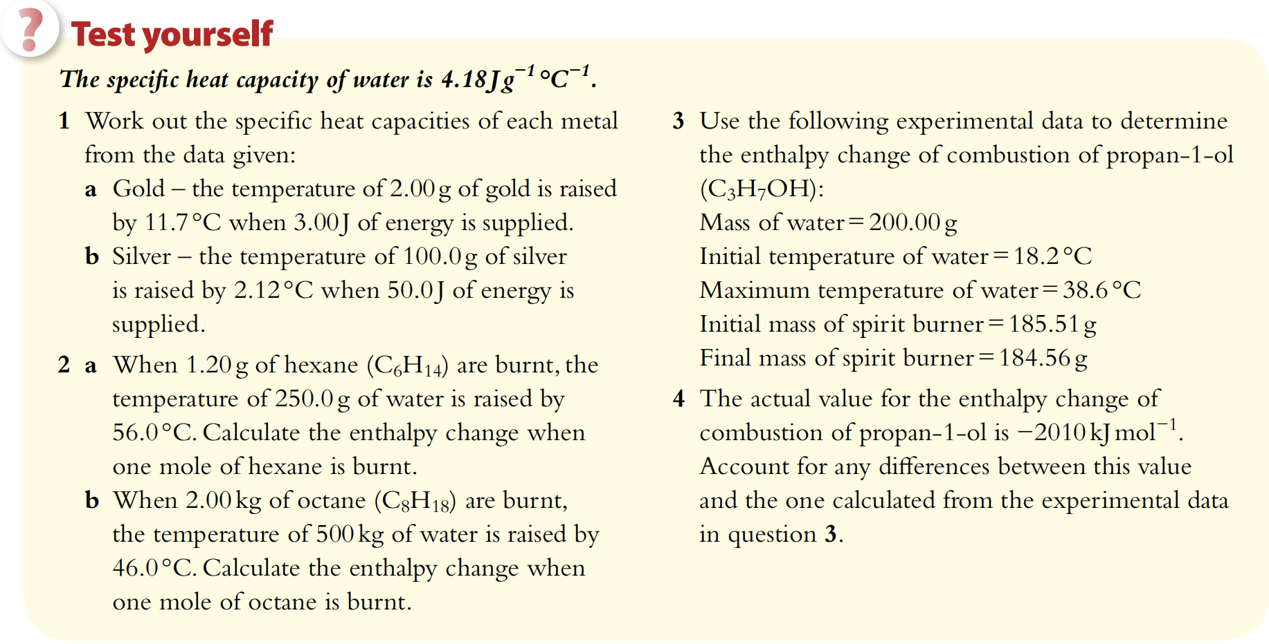
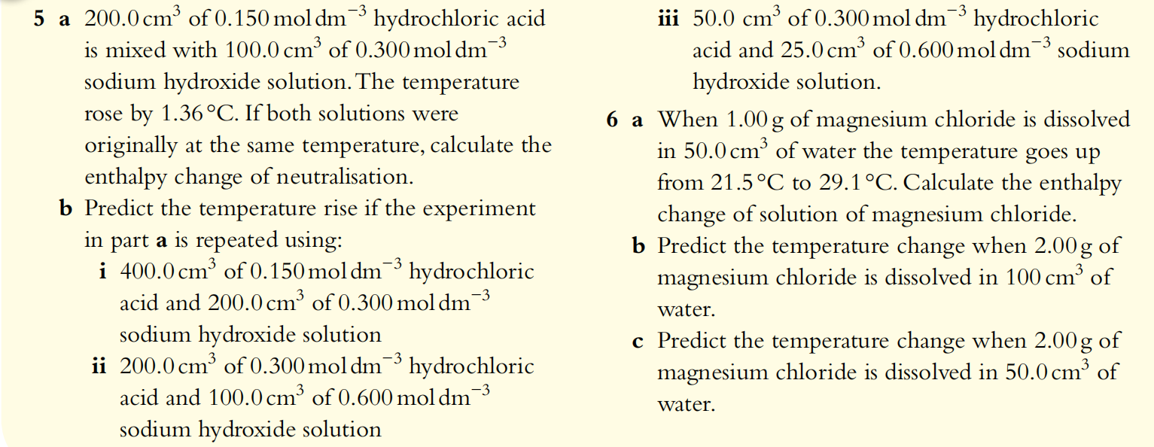

Slide 59
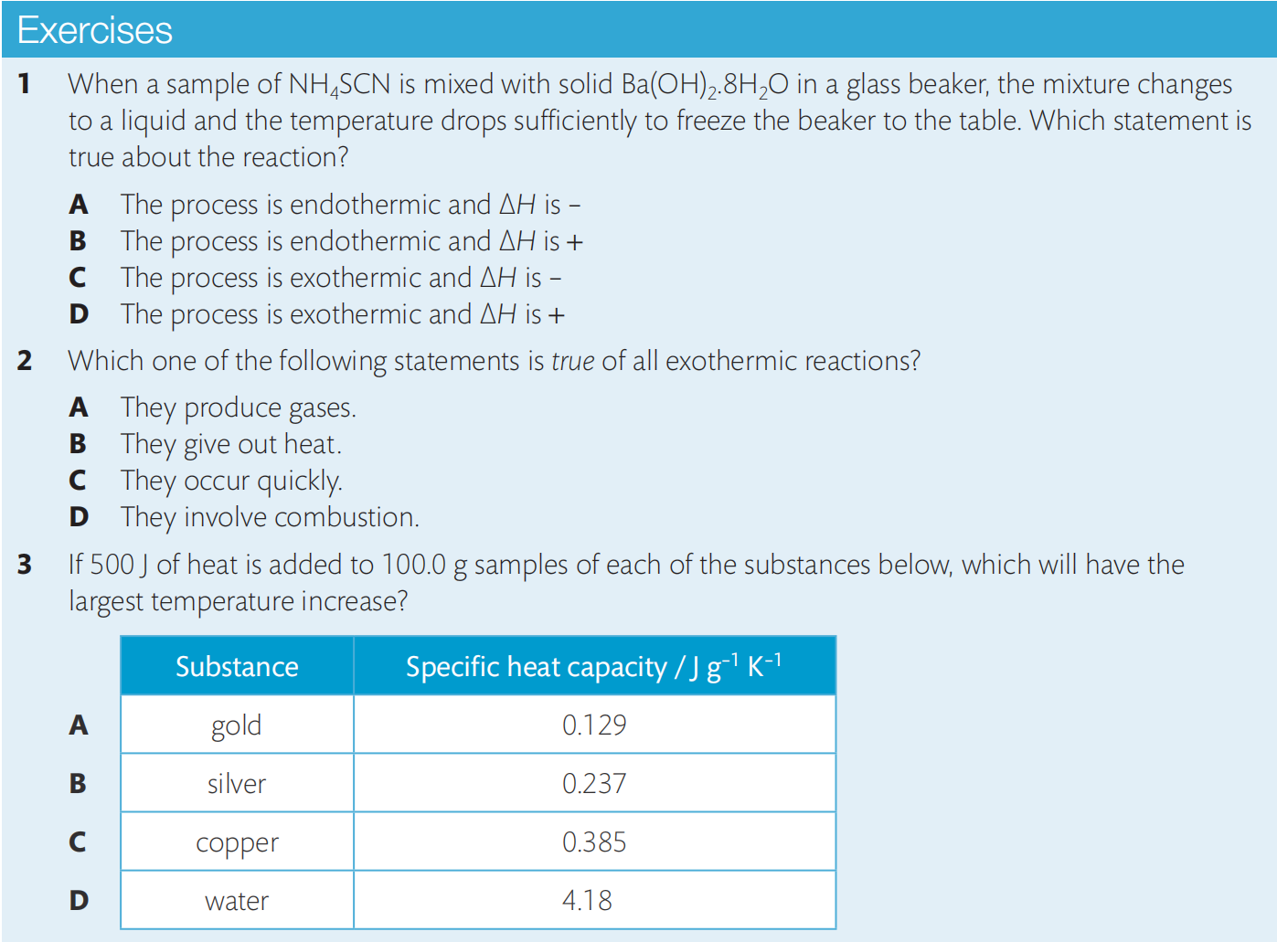

Slide 60
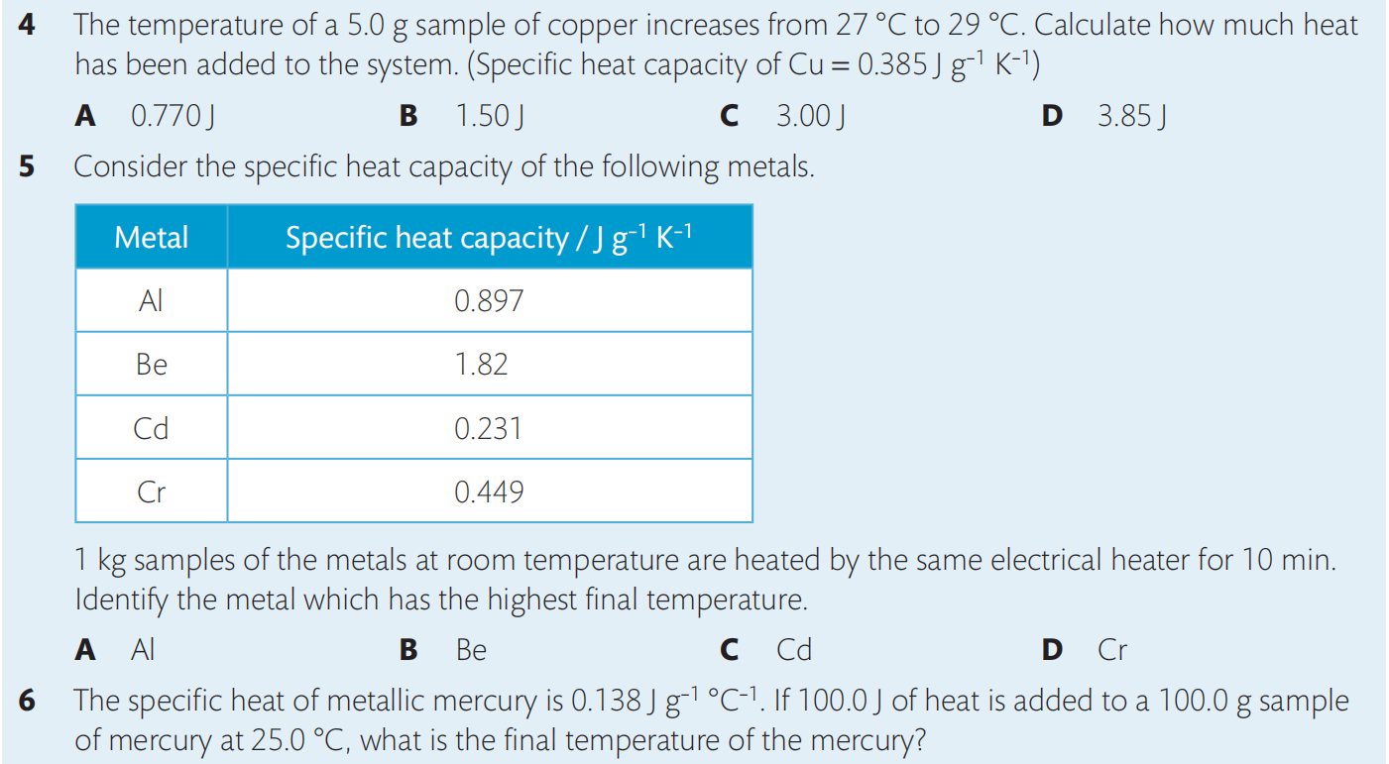

Slide 61
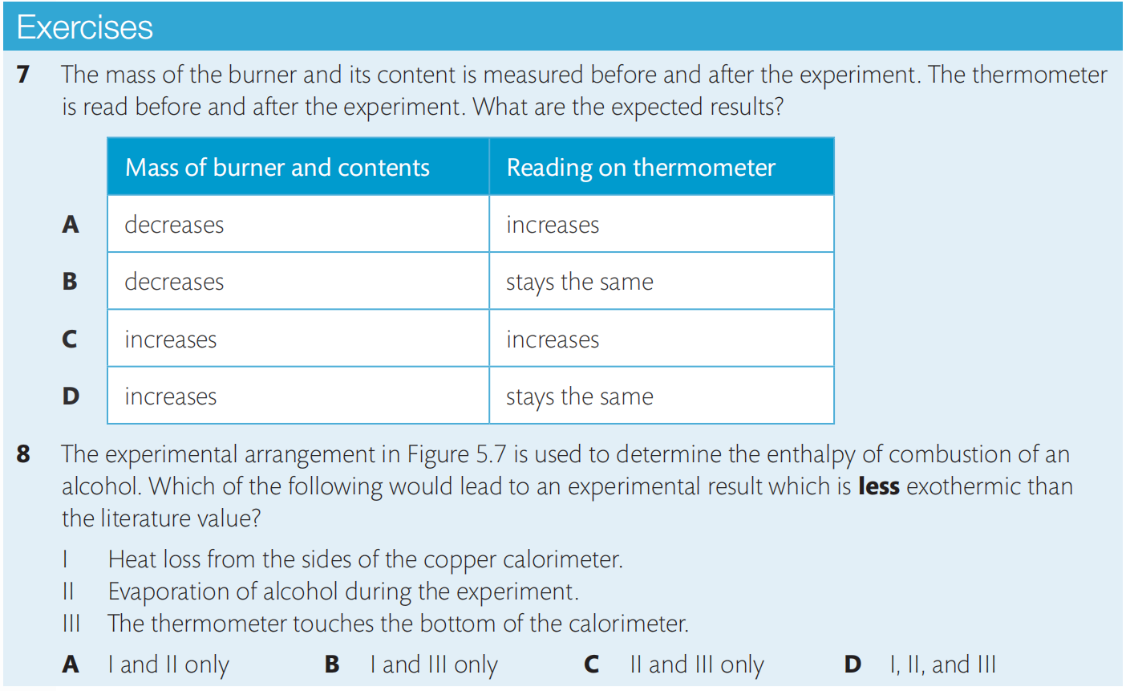

Slide 62
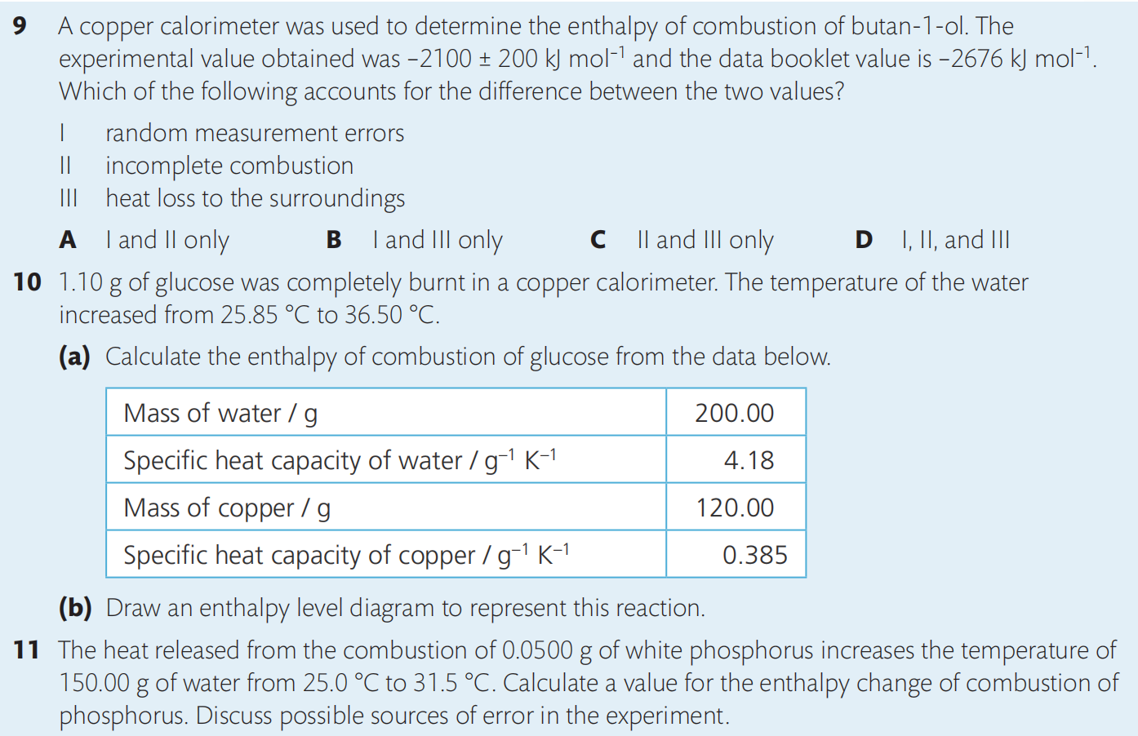
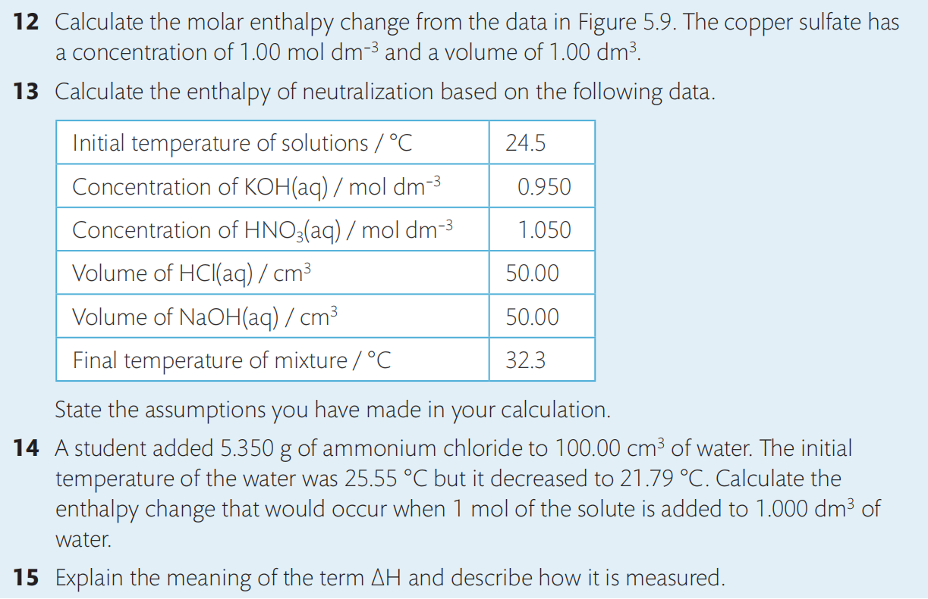

Slide 63
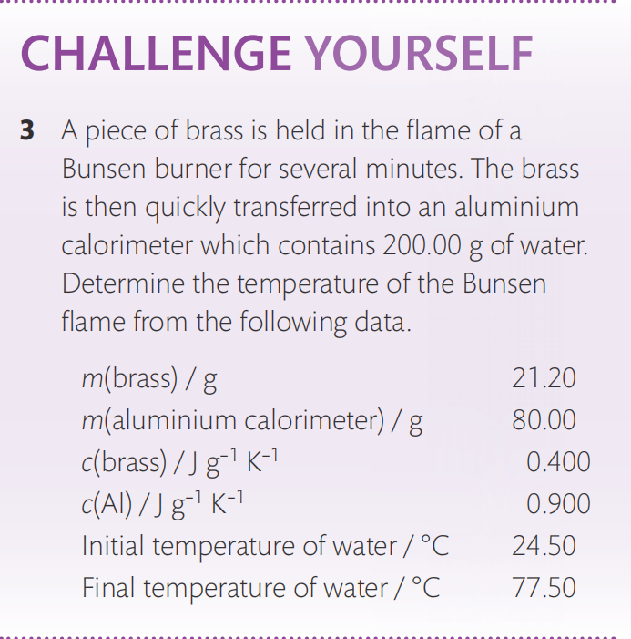
NaOH
HCl

Slide 64
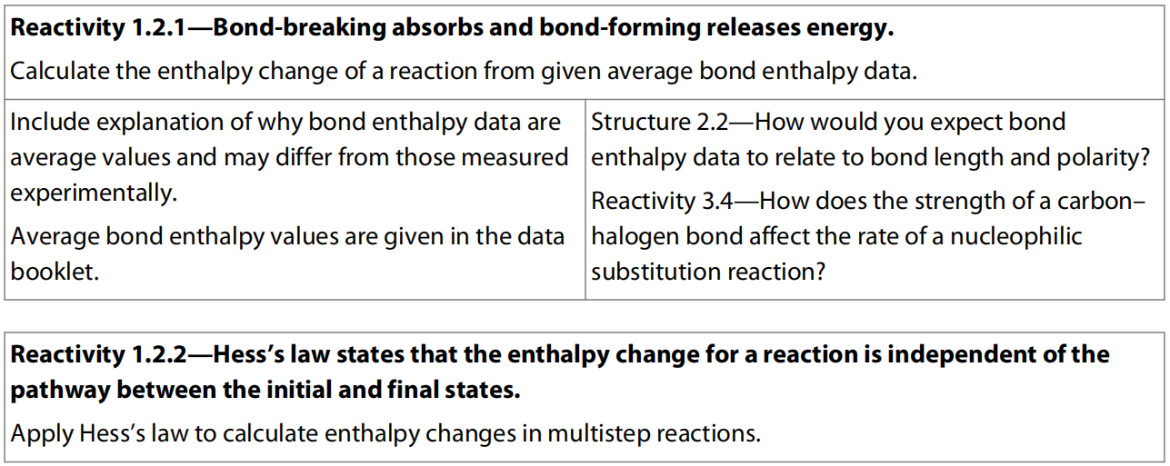
8.2 Hess’s Law

Slide 65
1st Law of Thermodynamics
Conservation of energy states that energy cannot be created or destroyed.
In chemistry, it means that the total change in chemical potential energy (∆ H) must be equal to the energy lost or gained by the system.

Slide 66
Hess’s Law
Hess’s Law: the total enthalpy change on converting a given set of reactants to a particular set of products is constant, irrespective of the way in which the change is carried out.

Slide 67
Reaction 1: A + B C+D ∆H₁
Reaction 2: 2A E+D ∆H₂
Reaction 3: E +2B 2C+D ∆H₃
What the relation between three reactions?

Slide 68
Reaction 1: A + B C+D ∆H₁
Reaction 2: 2A E+D ∆H₂
Reaction 3: E +2B 2C+D ∆H₃
What the relation between three reactions?
2 × Reaction 1 = Reaction 2 + Reaction 3
2 ∆H₁ = ∆H₂ + ∆H₃

Slide 69
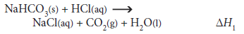
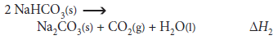
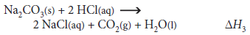
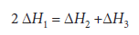
Reaction 1:
Reaction 2:
Reaction 3:

Slide 70
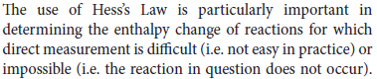
= -140kJ/mol
= ?
= -370kJ/mol

Slide 71
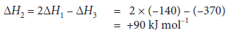
= -140kJ/mol
= ?
= -370kJ/mol

Slide 72
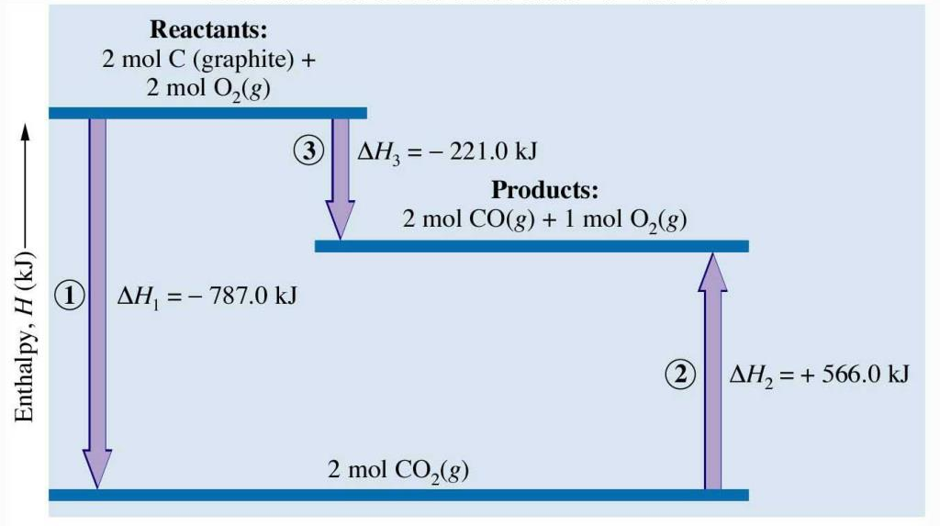
Enthalpy Diagram

Slide 73
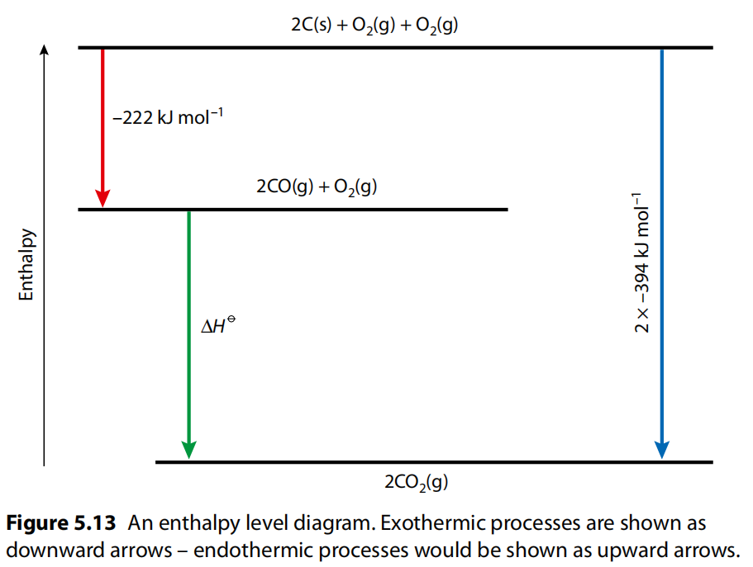

Slide 74
Practice 1:
①
②
① - ②

Slide 75
Practice 2:

Slide 76
Practice 3:

Slide 78
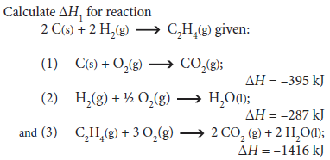
Practice 4:
/mol
/mol
/mol

Slide 79
Practice 5:
2B (s) + (3/2) O₂ (g) → B₂O₃ (s) ΔH = ?
B₂H₆ (g) + 3O₂ (g) → B₂O₃ (s) + 3H₂O (g) ΔH₁ = -2035 kJ/mol
H₂O (l) → H₂O (g) ΔH₂ = 44 kJ/mol
H₂O (l) → H₂ (g) + (1/2) O₂ (g) ΔH₃ = 286 kJ/mol
2B (s) + 3H₂ (g) → B₂H₆ (g) ΔH₄ = 36 kJ/mol

Slide 80
Practice 6:
Cl₂(g) → 2 Cl(g) ΔH⬇ = + 242 kJ mol⁻¹
H₂(g) → 2 H(g) ΔH⬇ = + 436 kJ mol⁻¹
HCl(g) → H(g) + Cl(g) ΔH⬇ = + 431 kJ mol⁻¹
H₂(g) + ½ O₂(g) → H₂O(g) ΔH⬇ = - 242 kJ mol⁻¹
O₂(g) → 2 O(g) ΔH⬇ = + 496 kJ mol⁻¹
Using above data to calculate the enthalpy change for the following reaction:
H₂(g) + Cl₂(g) → 2 HCl(g)

Slide 81
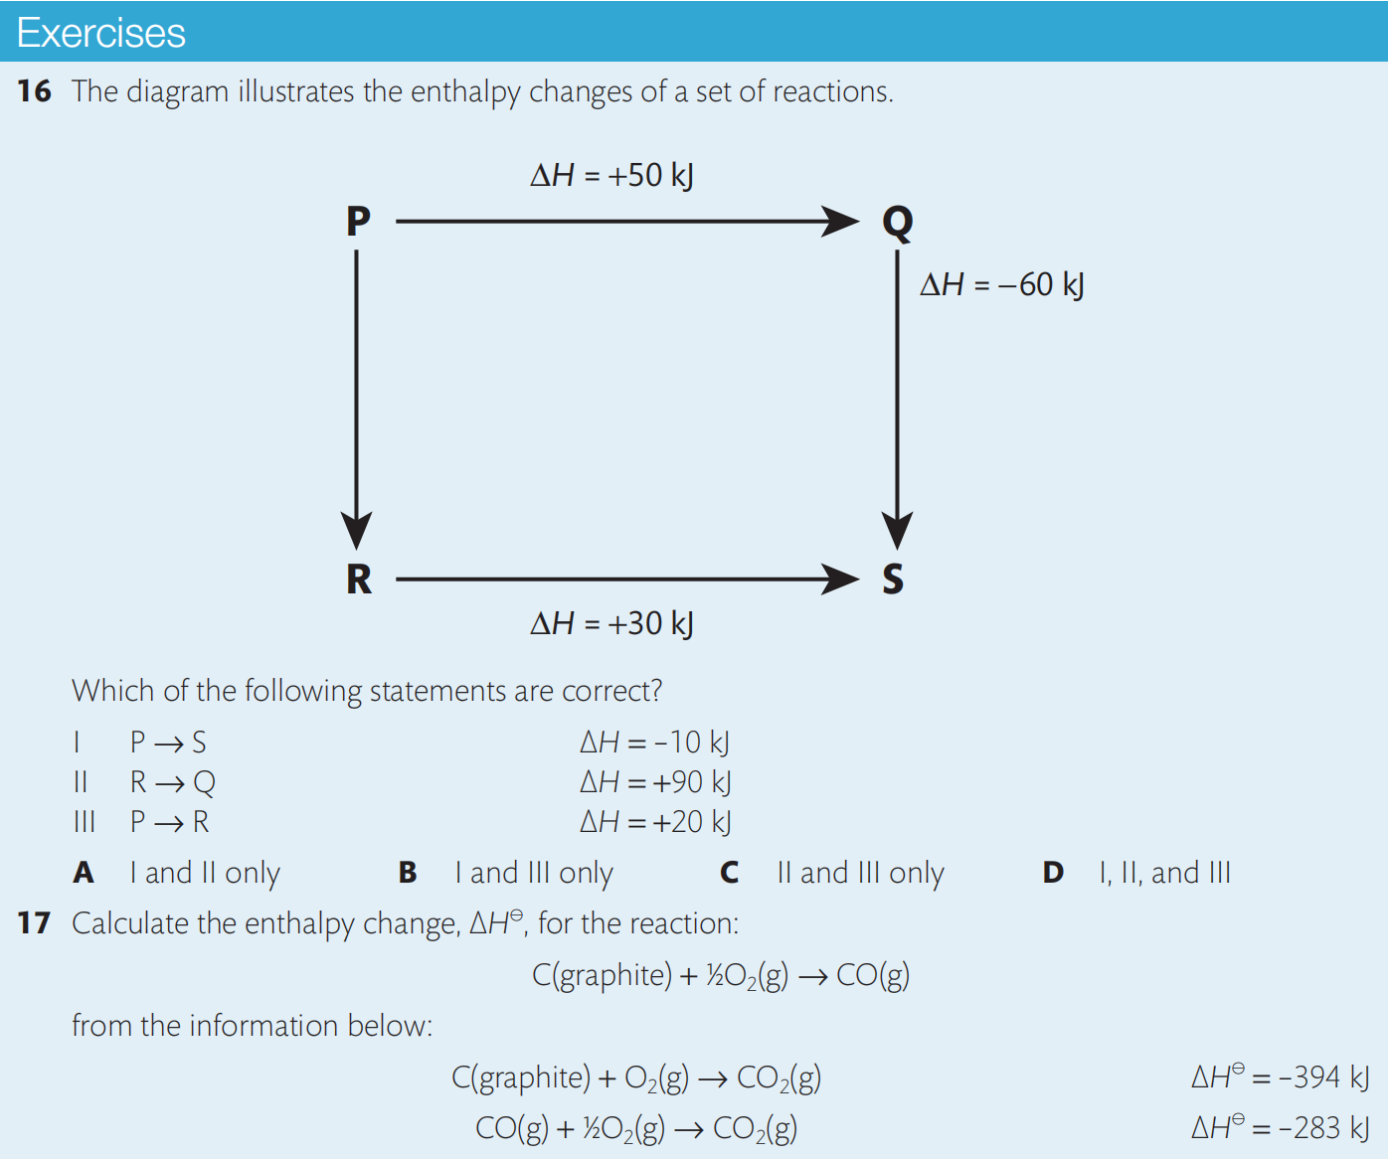

Slide 82
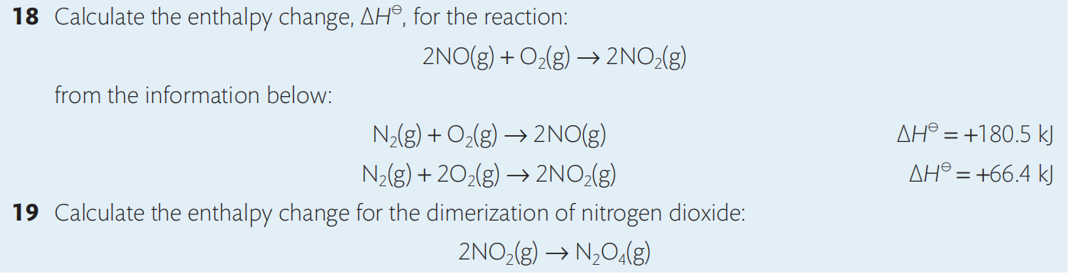
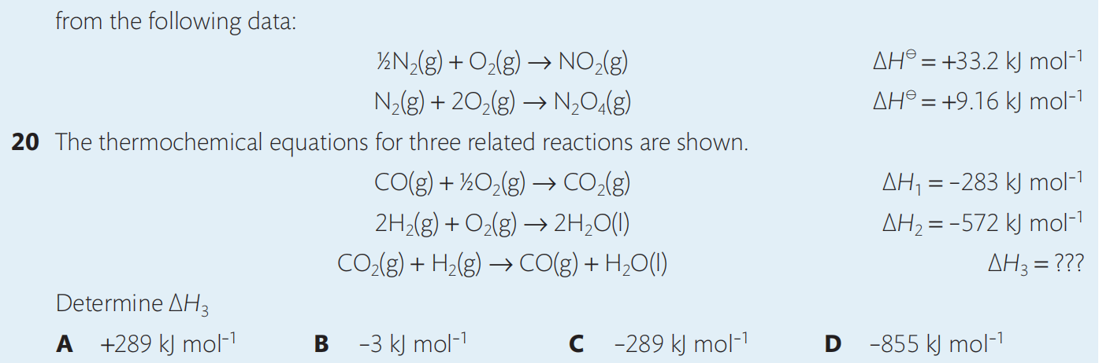

Slide 83
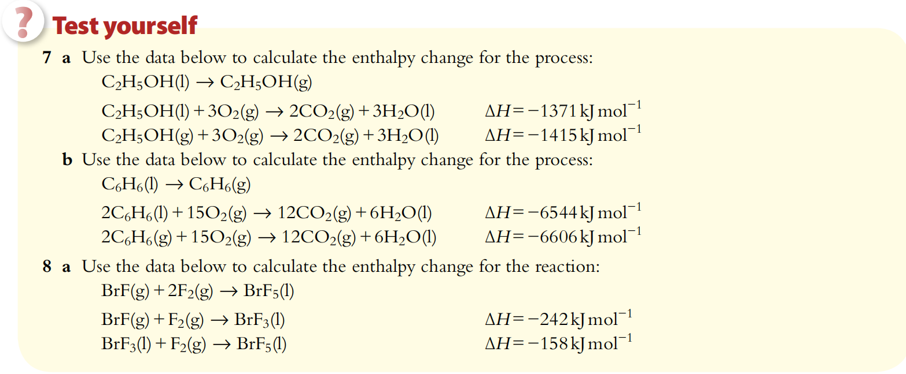
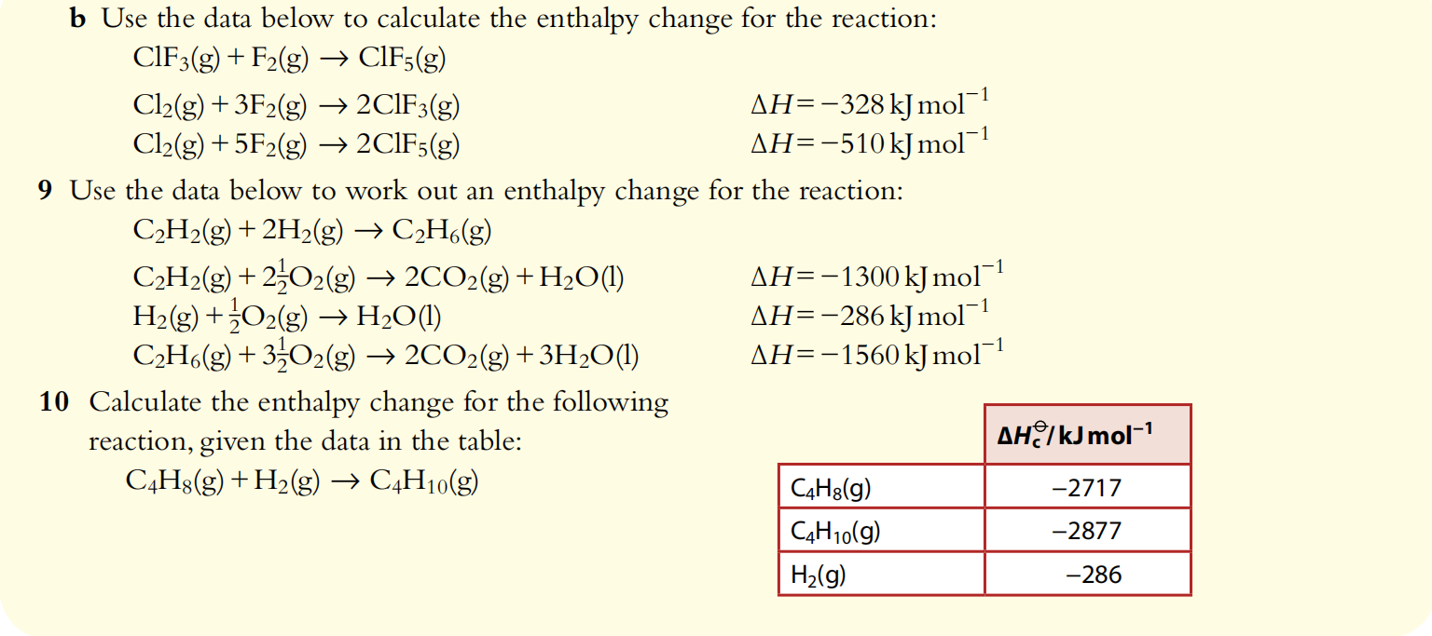

Slide 84
Breaking chemical bonds
Most chemicals will decompose (break up) if we heat them strongly enough.
This indicates that breaking chemical bonds requires energy – is an endothermic process.
Heat taken in
Energy needed to overcome the bonding between the atoms
Energy in chemicals
Energy needed

Slide 85
Making chemical bonds
It is reasonable to assume that bond making will be the opposite of bond breaking
Energy will be given out in an exothermic process when bonds are formed.
Heat given out
Energy given out as bonds form between atoms
Energy in chemicals
Energy given out

Slide 86
Bond enthalpies are a measure of the strength of a covalent bond. They are for the breaking of one mole of covalent bonds under gaseous state. (the stronger the bond, the more tightly the atoms are joined together. )
Average bond enthalpy is the mean of the enthalpy required to break a particular covalent bond under gaseous state in a range of molecules. (C-H 413 kJ/mol in methane and ethanol, etc.)
All B.E. are positive values.

Slide 87
Stronger the bond
More stable the substance
Smaller the chemical potential energy of the substance
Chemical potential energy indicate the potential of a substance to undergo a change (e.g. chemical reactions, movement, vibrations)

Slide 88
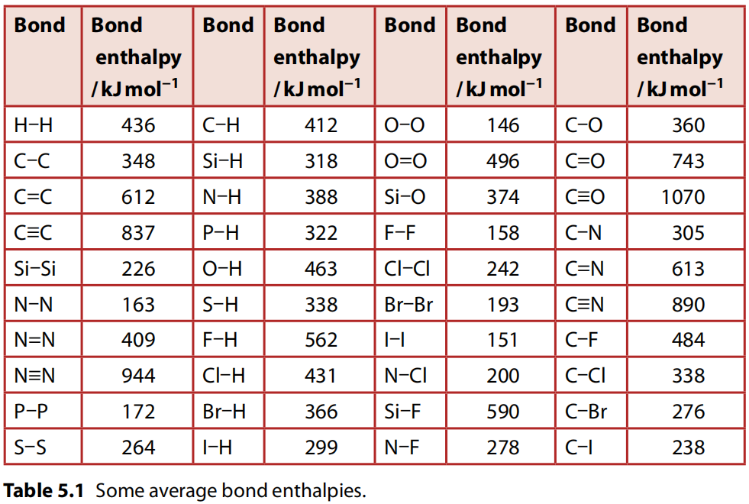

Slide 90
Bond Enthalpy V.S. bond order
Bond | Energy (kJ/mol)
N-N | 163
N=N | 409
N≡N | 944
Bond | Energy (kJ/mol)
C-C | 348
C=C | 612
C≡C | 837
Bond length V.S. bond order
As the bonds become stronger they also become shorter. This is because the electron density in the bond increase the attraction of the nuclei for these electrons, pulling the nuclei closer together.

Slide 91
Bond strength V.S. Atom size and its electronegativity
Influence of Atomic size
Influence of Atom electronegativity
Bond | Energy (kJ/mol)
C-C | 348
Si-Si | 226
Bond | Energy (kJ/mol)
C-C | 348
C-O | 360
C-F | 484

Slide 92
Bond strength V.S. Atom size and its electronegativity
Special case due to extreme high electronegativity of both atoms
Bond | Energy (kJ/mol)
F-F | 158
Cl-Cl | 243
Br-Br | 193
I-I | 151
Bond | Energy (kJ/mol)
O-O | 146
S-S | 266
Lone pair electrons in F-F and O-O weaken the bonding due to the lone pair - lone pair repulsion caused by the extreme small bond length.

Slide 93
Changes to chemical bonds Endothermic Reactions
In most chemical reactions some existing bonds are broken (endothermic)
But new bonds are made (exothermic)
Energy given out as new bonds form
Energy taken in as old bonds break
Overall endothermic in this case
Energy in chemicals
ΔH
products
reactants

Slide 94
Changes to chemical bonds Exothermic Reactions
Again some existing bonds are broken (endothermic)
And new bonds are formed (exothermic)
Energy taken in as old bonds break
Overall exothermic – in this case
Energy in chemicals
Energy given out as new bonds form
reactants
ΔH
products

Slide 95
Summary – Bond Changes
Where the energy from bond forming exceeds that needed for bond breaking the reaction is exothermic.
Where the energy for bond breaking exceeds that from bond forming the reaction is endothermic.
Exo
Endo
Bonds break
Bond forming
Bonds form
Energy in chemicals
Energy in chemicals
Bonds break
products
reactants
ΔH
ΔH
products
reactants

Slide 96
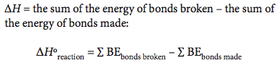
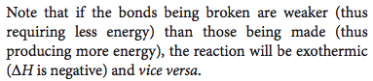
Enthalpy change of reaction (involving only covalent bonds)

Slide 97
Burning Methane
This is an exothermic reaction
C
H
H
H
H
Bond
Breaking
O
O
O
O
Bond
Forming
H
O
Energy in chemicals
O
C
O
O
H
ΔH
O
H
H
H
H
O
O
C
O
H
H
Progress of reaction

Slide 98
Practice 1:
Combustion of methane:
Calculate energy for bond breaking.
Calculate the energy from bond making
What is the value of ΔH for the reaction shown
Bond | Energy (kJ/mol)
C-H | 413
C=O | 805
H-O | 464
O=O | 498
H
O
O
C
O
O
H
H
H
O
H
H
O
O
C
O
H
H

Slide 99
Answer
Bond | Energy (kJ/mol)
C-H | 413
C=O | 805
H-O | 464
O=O | 498
Bond broken.
4(C-H) + 2(O=O)
=1652+996 = 2648 kJ/mol
Bond made:
4(O-H) + 2(C=O)
=1856+1610 = 3466 kJ/mol
ΔH = (ΣBE_{bonds broken}-ΣBE_{bonds made})
= 2648 – 3466 = -818 kJ/mol
(Exothermic)
H
O
O
C
O
O
H
H
H
O
H
H
O
O
C
O
H
H

Slide 100
Practice 2:
Hydrogen peroxide decomposes as shown:
Calculate energy for bond breaking.
Calculate the energy from bond making
What is the value of ΔH for the reaction shown
H
Bond | Energy (kJ/mol)
H-O | 464
O-O | 146
O=O | 498
O
O
H
H
O
O
H
O
O
O
H
H
O
H
H

Slide 101
Answer
Bond broken.
4(O-H) + 2(O-O)
=1856+292 = 2148kJ/mol
Bond made:
4(O-H) + 1(O=O)
=1856+498 = 2354kJ/mol
ΔH = (ΣBE_{bonds broken}-ΣBE_{bonds made})
= 2148 – 2354 = -206kJ/mol
(Exothermic)
Bond | Energy (kJ/mol)
H-O | 464
O-O | 146
O=O | 498
H
O
O
H
H
O
O
H
O
O
O
H
H
O
H
H

Slide 102

Most B.E. are not measured directly,
but calculated using Hess’s Law
Practice 3:
Use the data provided below to obtain the value for the bond enthalpy of the C-H bond.
ΔH₁= -75kJ/mol
ΔH₂= 725kJ/mol
ΔH₃= 436kJ/mol

Slide 103
Most bond enthalpies used in calculation are average bond enthalpies so are NOT so accurate to that particular compound.
Some covalent bonds only have specific bond enthalpies rather than average ones.
E.g. F-F, Cl-Cl, Br-Br, O=O, N≡N.
Most of time, calculating enthalpy change of reaction using bond enthalpies are less accurate than using Hess’s Law or data of standard enthalpy changes of formation/combustion.

Slide 104



Slide 105


Slide 106


Slide 107

8.3 Energy from Fuels

Slide 108


Slide 109
Combustion
In combustion reactions, substances are burned in oxygen and would release energy.
Metals, non-metals and hydrocarbons all react with oxygen when combusted, producing different products.

Slide 110
Combustion of metals
The combustion of reactive metals in the presence of oxygen results in the oxidation of the metal, the reduction of oxygen, and the formation of an ionic compound.
This type of reaction is therefore known as a redox reaction.
Oxidation can be defined as gain of oxygen or loss of electrons.
Reduction is defined as loss of oxygen or gain of electrons.

Slide 111
The general equation for the reaction of a metal with oxygen is as follows:
metal + oxygen → metal oxide
Lithium burns in oxygen to release heat and produce lithium oxide:
4 Li(s) + O₂(g) → 2 Li₂O(s)
Magnesium readily reacts with oxygen, producing a brilliant white light and magnesium oxide:
2 Mg(s) + O₂(g) → 2 MgO(s)
In both of these reactions, the reactive metals are being oxidized to form metal ions. The half-equations for each of these metals reveal the loss of electrons:
Li → Li⁺ + e⁻
Mg → Mg²⁺ + 2 e⁻
The oxygen atoms are reduced to form O²⁻ ions in each reaction by gaining electrons:
O₂ + 4 e⁻ → 2 O²⁻

Slide 112
Combustion of non-metals
Non-metals are also oxidized when combusted in oxygen, forming non-metal oxides:
non-metal + oxygen → non-metal oxide
Sulfur, a non-metal, can be found as impurities in fossil fuels, such as coal and crude oil. Coal may contain up to 3% of sulfur. The combustion of sulfur containing compounds in oxygen predominantly produces sulfur dioxide, SO₂:
S(s) + O₂(g) → SO₂(g)

Slide 113
Sulfur dioxide can then further react with oxygen in the atmosphere to produce sulfur trioxide:
2 SO₂(g) + O₂(g) ⇌ 2 SO₃(g)
Sulfur trioxide reacts with water in the atmosphere, to form sulfuric acid:
SO₃(g) + H₂O(l) → H₂SO₄(aq)
In industry, sulfur dioxide is produced in vast quantities as feedstock for the synthesis of sulfuric acid. The majority of the sulfuric acid is then used in the production of fertilizers, along with paper, paints, textiles and a wide variety of other products.

Slide 114
Complete combustion of organic compounds
Hydrocarbons are organic compounds composed only of carbon and hydrogen atoms.
Alkanes are the simplest hydrocarbons, which are present in fossil fuels, such as crude oil and natural gas.
They are relatively inert. This is because they have a low bond polarity, strong covalent carbon–carbon bonds (bond enthalpy = 346 kJ mol⁻¹) and strong carbon–hydrogen bonds (bond enthalpy = 414 kJ mol⁻¹).
However, alkanes do participate in some reactions, including combustion.

Slide 115
Alkanes are commonly used as fuels, releasing large amounts of energy in combustion reactions.
For combustion to occur, a fuel must be volatile.
Volatility is the tendency of a substance to change state from liquid to gas.
As the length of the carbon chain increases in the alkane series, the boiling point also increases, and therefore volatility decreases.
As a result, short-chain alkanes tend to be used as fuels.
Liquefied petroleum gas (LPG) consists predominantly of compressed propane, C₃H₈, while petrol (gasoline) is a mixture of hydrocarbons from butane, C₄H₁₀, to dodecane, C₁₂H₂₆.

Slide 116
Combustion of alkanes as fuels
Alkanes are widely used as fuels, in internal combustion engines and household heating for example, because the reactions of combustion are highly exothermic.
This is mainly because of the large amount of energy released in forming the double bonds in CO₂ and the bonds in H₂O.

Slide 117
Complete combustions
Alkanes burn in the presence of excess oxygen to produce carbon dioxide and water.
This is known as complete combustion because the products are fully oxidized. For example:
It can be generally written as:
C_{n}H_{2n+2} + [n+(n+1)/2] O₂ → n CO₂ + (n+1) H₂O
Actually all hydrocarbons can undergo complete combustion according to the following equation:
C_{x}H_{y} + (x+y/4) O₂ → x CO₂ + y/2 H₂O
Petrol, also known as gasoline, is a mixture of hydrocarbons obtained from oil, with octane present in the highest proportion. The reaction for the combustion of octane is shown below:
C₈H₁₈(l) + 25/2 O₂(g) → 8 CO₂(g) + 9 H₂O(l) ∆H_{c}º= −5470 kJ mol⁻¹

Slide 118
Incomplete combustion
However, when the oxygen supply is limited, incomplete combustion occurs giving rise to carbon monoxide and water. For example:
2 C₃H₈ (g) + 7 O₂ (g) → 6 CO (g) + 8 H₂O (g)
Or more general:
C_{x}H_{y} + (x/2+y/4) O₂ → x CO + y/2 H₂O
In conditions of extreme oxygen limitation, carbon will also be produced. For example:
C₃H₈ (g) + 2 O₂ (g) → 3 C (s) + 4 H₂O (g)
Or more general:
C_{x}H_{y} + y/4 O₂ → x C + y/2 H₂O

Slide 119
Other hydrocarbons, the alkenes, alkynes, and arenes, similarly undergo complete or incomplete combustion depending on the availability of oxygen, with the release of large amounts of energy.
As the C : H ratio increases with unsaturation, there is an increase in the smokiness of the flame, due to unburned carbon.
The products of all these reactions have serious impact on the environment, which is why the burning of these and other fossil fuels on a very large scale is widely recognized as a global problem.

Slide 120
Environmental Problems of burning alkanes
1. Carbon dioxide and water are both so-called greenhouse gases, which means that they absorb infrared radiation and so contribute to global warming and climate change.
Rising levels of carbon dioxide are largely implicated in the increase in average world temperatures over the last century.
2. Carbon monoxide is a toxin because it combines irreversibly with the hemoglobin in the blood and prevents it from carrying oxygen.
Slow idling vehicle engines in regions of high traffic densities produce higher concentrations of carbon monoxide.
It is essential to provide adequate ventilation when these fuels are being burned in a con ned space, to avoid carbon monoxide poisoning which can be fatal.
3. Unburned carbon is released into the air as soot or particulates, which have a direct effect on human health, especially the respiratory system.
In addition, these particulates act as catalysts in forming smog in polluted air, and have also been targeted as the source of another serious environmental problem known as global dimming.

Slide 121

O

Slide 122
Combustion of alcohols as fuels
Alcohols are another class of organic compounds. They have a wide range of applications, such as fuels, solvents and antiseptics.
Like alkanes, alcohols undergo complete combustion reactions releasing carbon dioxide and water.
The general equation for the complete combustion of alcohols is shown below:
alcohol + oxygen → carbon dioxide + water
C_{n}H_{2n+1}OH + 3n/2 O₂ → n CO₂ + (n + 1) H₂O

Slide 123
Ethanol is used in medicine for its antiseptic properties. It is also used as a fuel for vehicle engines. It is known as a biofuel because it can be produced by plants, a renewable resource, as opposed to fossil fuels, the supply of which is infinite.
The reaction for the complete combustion of ethanol is shown below:
C₂H₅OH(l) + 3 O₂(g) → 2 CO₂(g) + 3 H₂O(l) ∆H_{c}⦵= −1367 kJ mol⁻¹
This reaction is strongly exothermic. The use of ethanol as a renewable biofuel is increasing.
The scientific community is working to resolve the problems associated with the production of biofuels, such as the high cost of production, the impact of using farmland on food supply, and the lower amount of energy produced per unit mass or volume of the fuel.

Slide 124
These incomplete combustion reactions can occur simultaneously with complete combustion reactions in different ratios. Incomplete combustion reactions are less exothermic than the corresponding complete combustion reactions.
Incomplete combustion can be observed in the laboratory, with the appearance of black soot on the bottom of container that has been heated over a Bunsen or spirit burner flame.
This could increase the mass of the container so could cause systematic error in quantitative experiments.

Slide 125





Slide 126
Fossil Fuels
Fossil fuels include crude oil, coal and natural gas.
Crude oil, or petroleum, is a non-renewable resource, and its use as a fuel is deeply embedded in the global society. Crude oil is a natural mixture of hydrocarbons, organic compounds containing nitrogen, sulfur and oxygen, and a wide variety of other elements.
Coal, petroleum and natural gas are the main fuels used to generate electricity in power stations and the internal combustion engines of cars. As the global demand for energy increases, so does the consumption of fossil fuels.
Globally, governments are making plans and legislating to limit the consumption of fossil fuels and promote the use of renewable energy. However, the transition to clean energy will take many decades.
One consequence of the use of fossil fuels is the release of large quantities of carbon dioxide, a product of the combustion reaction, into the atmosphere.
Carbon dioxide is a greenhouse gas, which means that it traps heat energy inside the Earth’s atmosphere. This is known as the greenhouse effect.

Slide 127


Slide 128
Greenhouse Effect
Carbon dioxide, CO₂, constitutes approximately 0.04% of the atmosphere.
Despite the small proportion of carbon dioxide, the increase in the concentration of this greenhouse gas is causing significant damage to our environment.
A carbon dioxide molecule can absorb infrared radiation resulting in the vibration of bonds within the molecule.
After absorbing the infrared radiation and undergoing vibration, the molecule will emit infrared radiation back into the atmosphere.
Some of this radiation will be directed towards the Earth’s surface, which will increase the global temperature.

Slide 129
Other greenhouse gases include methane, nitrous oxide, water vapour and fluorinated substances such as hydrofluorocarbons.
As a result of the greenhouse effect, average temperatures around the world are increasing, which is known as global warming.
There is widespread agreement in the scientific community that the main cause of global warming is the increase in the levels of greenhouse gases: in particular, carbon dioxide, and to a lesser extent, methane.

Slide 130



Slide 131

Specific energy
Many different sources of fuels are used in everyday life. The choice of fuels depends on the economic development of nations and the natural resources available.
Each fuel has a different specific energy: the amount of heat energy released per mass of the fuel.
Wood, a traditional means of generating energy for cooking and heating, has the lowest specific energy of all common fuels.
Common fuels vary in composition. The chain length of hydrocarbons present in these fuels also varies.
In general, the longer the hydrocarbon chain, the greater the tendency of the fuel to undergo incomplete combustion.
As discussed, incomplete combustion results in the release of poisonous carbon monoxide and/or elemental carbon (soot). But it also produces a smaller amount of heat energy per unit mass of the fuel when compared to the complete combustion of the same hydrocarbon.
Larger hydrocarbons have a reduced volatility due to stronger London (dispersion) forces (LDFs). This affects the way the hydrocarbon molecules interact with the oxygen molecules and the type of combustion that occurs.

Slide 132


Slide 133
Biofuels
Biofuels are renewable resources, produced from organic compounds, which in turn are generated from carbon dioxide during biological processes.
The production of organic compounds from carbon dioxide is known as biological carbon fixation.
For example, green plants use photosynthesis to absorb carbon dioxide from the atmosphere and transform it into glucose, which can be converted into ethanol, a biofuel, by fermentation.
In the process of photosynthesis, radiant energy in the form of sunlight is converted by plants into chemical energy. Plants contain chlorophyll molecules, which are capable of absorbing light energy. This light energy is used for photosynthesis, a complex series of reactions that results in the conversion of carbon dioxide and water into glucose, C₆H₁₂O₆, and oxygen:
6 CO₂(g) + 6 H₂O(l) → C₆H₁₂O₆(aq) + 6 O₂(g)
Glucose stores chemical energy in its bonds. Photosynthesis is an example of biological fixation of carbon.

Slide 134
Fermentation
The fermentation of glucose produces ethanol,C₂H₅OH, a biofuel:
C₆H₁₂O₆(aq) → 2 C₂H₅OH(aq) + 2 CO₂(g)
Carbon dioxide, a greenhouse gas, is also produced in the fermentation process.
However, this is offset by the absorption of a greater amount of carbon dioxide in the process of photosynthesis.
The industrial production of biofuels in many countries has economic and environmental implications. Brazil has undertaken large-scale production of ethanol from sugarcane for decades.
An increased demand for renewable biofuels has both advantages and disadvantages.

Slide 135

Advantages & disadvantages of biofuels

Slide 136

8.4 Energy Cycles (Higher Level)

Slide 137



Slide 138
Standard Enthalpy Change of Reaction
The enthalpy change of a reaction depends on the physical state of the reactants and the products and the conditions under which the reaction occurs.
For this reason, standard enthalpy changes, ΔHº,which are measured under standard conditions of 298 K (25 °C) and 100 kPa, are generally tabulated.

Slide 139
Standard Enthalpy Change of Formation
The standard enthalpy change of formation, ΔH_{f}º , of a substance is the enthalpy change that occurs when ONE MOLE of the substance is formed from its elements in their standard states.
These standard measurements are taken at a temperature of 298 K (25 °C) and a pressure of 100 kPa.
The enthalpy change of formation of one of allotropes of each element is 0 since they form themselves. E.g. graphite, O₂.
Other allotropes of the same element would not have a ΔH_{f}ºof 0. E.g. diamond, O₃.
They are important as they:
give a measure of the stability of a substance relative to its elements
can be used to calculate the enthalpy changes of all reactions, either hypothetical or real.

Slide 140
ΔH_{f}º of NaOH:
Na(s) + 1/2 O₂(g) + 1/2 H₂(g) → NaOH(s)
ΔH_{f}º of C₂H₅OH:
2 C(graphite) + 3 H₂(g) + 1/2 O₂(g) → C₂H₅OH(l)
ΔH_{f}º of Ca₃(PO₄)₂:
3 Ca(s) + 1/2 P₄(s) + 4 O₂(g) → Ca₃(PO₄)₂(s)

Slide 142
Using standard enthalpy changes of formation
Standard enthalpy changes of formation can be used to calculate the standard enthalpy change of any reaction.

Slide 143
CaO(s) + H₂O(l) + 2 CO₂(g) → Ca(HCO₃)₂(s) ΔH_{r}º
Ca(s) + 1/2 O₂(g) → CaO(s) ΔH_{f}º_{CaO}
H₂(g) + 1/2 O₂(g) → H₂O(l) ΔH_{f}º_{H2O}
C(graphite) + O₂(g) → CO₂(g) ΔH_{f}º_{CO2}
Ca(s) + H₂(g) + 2 C(graphite) + 3 O₂(g) → Ca(HCO₃)₂(s) ΔH_{f}º_{Ca(HCO3)2}
ΔH_{r}º = ΔH_{f}º_{Ca(HCO3)2} - (ΔH_{f}º_{CaO} + ΔH_{f}º_{H2O} + 2 × ΔH_{f}º_{CO2})

Slide 145
Practice 1:

Slide 147
Practice 3:

Slide 150
Standard Enthalpy Change of Combustion
The standard enthalpy change of combustion, ΔH_{c}º , of a substance is the enthalpy change for the complete combustion of ONE MOLE of a substance in its standard state in excess oxygen under standard conditions (298 K, 100 kPa).

Slide 152
Practice 4:
c
c

Slide 153
Practice 5:

Slide 156


Slide 157




Slide 158


Slide 159
First ionization energies and electron affinities

Slide 160
Lattice enthalpies
Add the equations for first ionization energy and first electron affinity:
We can now see that the electron transfer process is endothermic overall and so energetically unfavorable.
But next the oppositely charged gaseous ions come together to form an ionic lattice; this is a very exothermic process as there is strong attraction between the oppositely charged ions:

Slide 161
It is this step of the process which explains the readiness of sodium and chlorine to form an ionic compound.
The lattice enthalpy (ΔH_{lat}^{θ}) expresses this enthalpy change in terms of the reverse endothermic process. The lattice enthalpy is the enthalpy change of the formation of gaseous ions from one mole of a solid crystal breaking into gaseous ions. For example, sodium chloride:

Slide 162
Experimental lattice enthalpies and the Born–Haber cycle
Experimental lattice energies cannot be determined directly. An energy cycle based on Hess’s law, known as the Born–Haber cycle is used.
The formation of an ionic compound from its elements is supposed to take place in a number of steps including the formation of the solid lattice from its constituent gaseous ions.
From Hess’s law, the enthalpy change for the overall formation of the solid must be equal to the sum of the enthalpy changes accompanying the individual steps.

Slide 163
Consider, for example, the formation of sodium chloride:
This can be considered to take place in several steps as shown in the table below.

Slide 167


Slide 168
Example:

Slide 169
2-

Slide 171
Theoretical lattice enthalpies can be calculated from the ionic model
Theoretical lattice enthalpies can be calculated by assuming the crystal is made up from perfectly spherical ions.
This ionic model assumes that the only interaction is due to electrostatic forces between the ions.
Consider, for example, the formation of the ion pair in Figure 5.20.

Slide 172
The energy needed to separate the ions depends on the product of the ionic charges and the sum of the ionic radii.
An increase in the ionic radius of one of the ions decreases the attraction between the ions.
An increase in the ionic charge increases the ionic attraction between the ions.
To calculate the lattice energy for one mole, more ion interactions need to be considered as a solid crystal forms (Figure 5.21).
The overall attraction between the positive and negative ions predominates over the repulsion of ions with the same charge as ions are generally surrounded by neighboring ions of opposite charge.

Slide 173
This leads to the general expression:
where K is a constant that depends on geometry of the lattice and n and m are the magnitude of charges on the ions.
As the ionic radii (R_{Mn+} + R_{Xm−}) can be determined from X-ray diffraction measurements of the crystal, theoretical values can be calculated once the geometry of the solid lattice is known.

Slide 174
Lattice enthalpies depend on the size and charge of the ions
The lattice enthalpies of the group 1 halides are given below.
We can see that the lattice enthalpies decrease as the size of the cation or anion increases.
LiF contains the ions with the smallest ionic radii and has the highest lattice enthalpy, and CsI contains the largest ions and the smallest lattice enthalpy.

Slide 175
The effect of charge is seen in the following comparisons.
So overall, we can see that lattice enthalpies are greater when ionic compounds form between smaller, more highly charged ions, that is those with the greatest charge density.

Slide 176
The trend in lattice enthalpies described does not apply universally
A comparison of the lattice enthalpies of AgI and NaI shows that AgI has the larger lattice enthalpy, despite Ag⁺ having a larger ion radius than Na⁺.
Obviously the bonding in AgI is stronger than accounted for by a purely ionic model.
The covalent character of a bond increases as the difference in electronegativity decreases, and in AgI the bonding is intermediate in character.
The additional contribution from covalent bonding accounts for the higher than expected lattice enthalpy.

Slide 177


Slide 178


Slide 179

8.5 Entropy & Spontaneity (Higher Level)

Slide 180


Slide 181
Entropy is a more complete direction of change
If a bottle of a carbonated drink is left open, we expect it to find it ‘flat’ after a couple of days. The carbon dioxide escapes from solution and diffuses or spreads out into the wider surroundings. We do not expect all the carbon dioxide to return at a later date.
In a similar way, a hot cup of coffee will cool down and lose some heat to the surroundings. The heat will not return.

Slide 182
Both these examples illustrate a general principle:
Energy and matter tend to disperse and the universe becomes more disordered.
These are both examples of spontaneous change; they occur naturally without the need to do work.
We can reverse the natural tendency of change but only at the expense of doing work.
Such everyday experiences can be expressed more precisely when the degree of disorder of a system is quantified by its entropy (S).
Entropy (S) refers to the distribution of available energy among the particles.

Slide 183
Entropy
Entropy is a measure of how the available energy is distributed among the particles.
The more disorder / the more random of a system, the higher entropy it contains.
S of a perfectly order crystal at absolute zero (0 K, -273 ºC) is zero.
Units: J K⁻¹ mol⁻¹
Five factors that change the entropy in a system
(1) state change
From solid liquid gas, entropy increase
reason: good order solid- a regular arrangement of particles
liquid- particles move more easily
disorder gas- particles move fast and independently

Slide 184
(2) Gas pressure increase, entropy decrease
reason: gas molecules has less ability to move
(3) A solid or liquid dissolves in a solvent
entropy increase particles more disorder
But, a gas dissolves into a solvent;
the S decrease from gas to liquid, less disorder
(4) Complex molecules with more atoms ( H₂SO₄) have higher S than simple molecules ( HCl)
(5) Hard solids with well order crystals ( Eg. Diamond) have lower entropy than soft, less order solids (Eg. K)

Slide 185
Predicting entropy changes
As the solid state is the most ordered state and the gaseous state the most disordered, we can predict that the entropy of a system increases as a solid changes to a liquid and as a liquid changes to a gas.
Similarly, doubling the number of particles present in a sample also increases the opportunity for a system to become disordered and for its entropy to increase.
More precisely, it can be shown that doubling the amount of a substance doubles the entropy.
Similar considerations allow us to predict the entropy changes of the system (ΔS) during any physical or chemical change.

Slide 188
When predicting entropy changes, the change due to a change in the number of particles in the gaseous state is usually much greater than any other possible factor.

Slide 189
Practice:

Slide 190
Absolute entropy
The absolute entropy of different substances can be calculated. As entropy depends on the temperature and pressure, tabulated entropy values refer to standard conditions and are represented as S^{ѳ}.
Section 12 of the IB data booklet has a list of values for organic compounds.

Slide 191
It should be noted that all entropy values are positive. A perfectly ordered solid at absolute zero has an entropy of zero. All other states, which are more disordered, have positive entropy values.

Slide 192

Calculating entropy changes

Slide 193
Practice:

Slide 194



Slide 195


Slide 196
2nd Law of Thermodynamics
The more ways the energy can be distributed the higher the entropy.
Ordered states, with a small energy distribution are said to have low entropy.
Disordered states, with a high energy distribution, have high entropy.
As time moves forward, matter and energy disperse and become more disordered, and the total entropy of the universe increases.

Slide 197
Spontaneity
Nature tends to greater disorder, hence any change may occur spontaneously (like water flowing downhill, sodium chloride (‘salt’) dissolving in water or a gas expanding to fill a container) if the final state is more probable than the initial state, that is, if as a result of the change the final entropy of the universe is greater than the initial entropy of the universe.
The entropy of the universe depends on both the entropy of the system and the entropy of the surroundings.
But ΔS measures only the change in the entropy of the system.

Slide 198
Entropy changes of the surroundings
The major effect of chemical changes on the entropy of the surroundings results from the gain and loss of heat energy.
If chemical potential energy is converted to heat energy which is then transferred to the universe (i.e. an exothermic change), then this results in an increase in the entropy of the surroundings, and vice versa for an endothermic change.
The magnitude of this entropy change ΔS_{surroundings}= –ΔH^{ѳ}/T, where T is the absolute temperature. The condition for a spontaneous change to occur is therefore that ΔS_{total} is positive, where ΔS_{total} is given by:

Slide 199
A change will be spontaneous if:
The final state has a lower enthalpy than the initial state (ΔH^{ѳ} is negative)
AND
The final state is more disordered than the initial state (ΔS^{ѳ} is positive).
If only one of these is the case then the outcome will depend on which factor is the dominant one at the temperature being considered.
If neither of these is the case then this reaction will never occur spontaneously.

Slide 200
ΔS(surroundings) and an explanation of the units of entropy
Entropies are generally expressed in the units J K^{–1} mol^{–1}.
These are consistent with its characterization as a distribution of available energy.

Slide 201
Gibbs free energy is a useful accounting tool
We have seen that for chemical reactions neither ΔH(system) nor ΔS(system) alone can reliably be used to predict the feasibility of a reaction.
The ultimate criterion for the feasibility of a reaction is:
This expression can be tidied up. Multiplying by T (as they are always positive) and then multiplying by –1 and reversing the inequality:

Slide 202
This combination of entropy and enthalpy of a system gives a new function known as the Gibbs free energy (ΔG(system)):
That is, ΔG(system) must be negative for a spontaneous process.
Whereas ΔH(system) is a measure of the quantity of heat change during a chemical reaction, ΔG(system) gives a measure of the quality of the energy available.
It is a measure of the energy which is free to do useful work rather than just leave a system as heat. Spontaneous reactions have negative free energy changes because they can do useful work.

Slide 203
we can think of the temperature, T, as a tap which adjusts the significance of the term ΔS(system) in determining the value of ΔG(system).
At low temperature:
ΔG(system) ≈ ΔH(system), as TΔS(system) ≈ 0
That is, all exothermic reactions can spontaneously occur at low temperatures, while all endothermic reactions cannot spontaneously occur at low temperatures.
At high temperature:
ΔG(system) ≈ –TΔS(system), as the temperature is sufficiently high to make the term ΔH(system) negligible.
This means all reactions which have a positive value of ΔS(system) would spontaneously occur at high temperatures, and all reactions that have a negative ΔS(system) would not spontaneously occur at high temperatures.

Slide 204
Example:

Slide 206
The effect of ΔH , ΔS , and T on the spontaneity of reaction
The effect of temperature on the spontaneous reactions for different reactions is summarized in the table below.

Slide 207
Calculating ΔG values
There are two routes to calculating changes in Gibbs free energy during a reaction.
ΔG (at 298 K) can be calculated from tabulated values of ΔG^{ѳ}_{f} in the same way enthalpy changes are calculated.
ΔG values are, however, very sensitive to changes to temperature, and ΔG values calculated using this method are not applicable when the temperature is changed. Changes in free energy at other temperatures can be obtained by applying the equation:

Slide 208
Calculating ΔG_{reaction} from ΔG^{ѳ}_{f}
ΔG_{reaction} for reactions at 298 K can be calculated from ΔG^{ѳ}f values in the same way ΔH_{reaction} can be calculated from ΔH^{ѳ}_{f} values.

Slide 209
Practice:

Slide 210
Using ΔS_{reaction} and ΔH_{reaction} values to calculate ΔG_{reaction} at all temperatures

Slide 211
Example

Slide 213



Slide 214




Slide 215


Slide 216



